Slide 1




Relationships Between Functionality, Security, and Privacy
For MPC, Hashing, and Encryption
Rio LaVigne
MIT

Slide 2
Functionality
Security
Privacy

Slide 3
Functionality
MPC
Security
Privacy

Slide 4

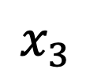
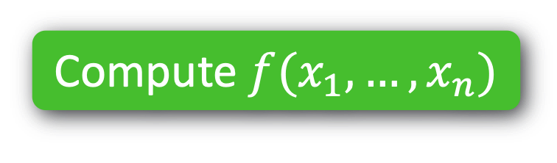
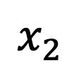
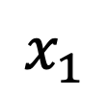
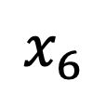
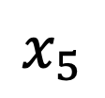
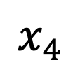
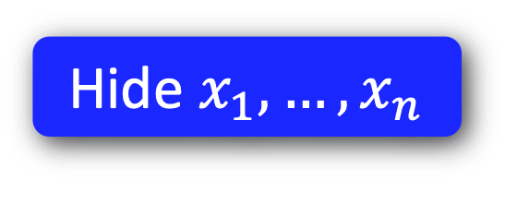
Functionality
MPC
MPC
Security
Compute $f(x_{1},…,x_{n})$
Passive
$$x_{2}$$
$$x_{1}$$
$$x_{3}$$
Active
$$x_{4}$$
$$x_{6}$$
$$x_{5}$$
Hide $x_{1},…,x_{n}$
Privacy

Slide 5
MPC
Compute $f(x_{1},…,x_{n})$
Passive
$$x_{2}$$
$$x_{1}$$
$$x_{3}$$
Active
$$x_{4}$$
$$x_{6}$$
$$x_{5}$$
Hide $x_{1},…,x_{n}$

Slide 6

Functionality
MPC
Security
Compute $f(x_{1},…,x_{n})$
Passive
Active
Hide $x_{1},…,x_{n}$
Privacy

Slide 7
Functionality
Hashing
Security
Privacy

Slide 8
Functionality
Hashing
Security

Slide 9

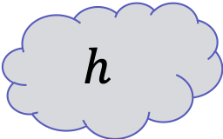
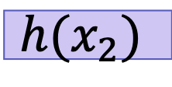

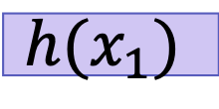

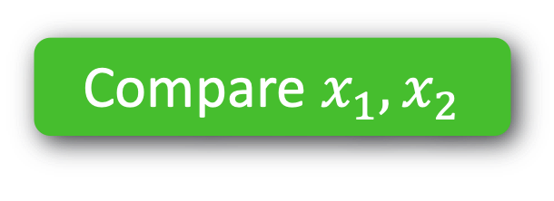

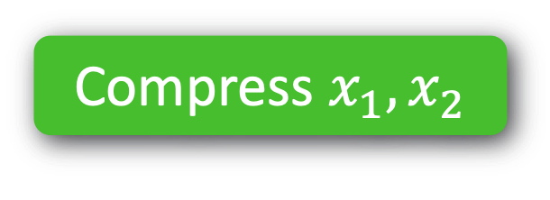

Functionality
Hashing
Security
Compare $x_{1}, x_{2}$
e.g. CRHF
Adaptive
Compress $x_{1}, x_{2}$
$$h$$
$$?$$
$$=$$
$$x_{1}$$
$$x_{2}$$
$$?$$
$$=$$
$$h(x_{1})$$
$$h(x_{2})$$

Slide 10


Hashing
Compress $x_{1}, x_{2}$
Adaptive
Compare $x_{1}, x_{2}$
$$h$$
$$?$$
$$=$$
$$x_{1}$$
$$x_{2}$$
$$?$$
$$=$$
$$h(x_{1})$$
$$h(x_{2})$$
e.g. CRHF

Slide 11
Functionality
Encryption
Security

Slide 12


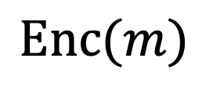
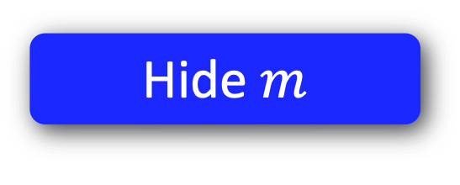

Functionality
Encryption
Security
Send message $m$
Eavesdropper
Poly-time
$$\text{Enc}(m)$$
Hide $m$
Privacy

Slide 13


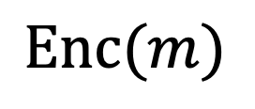
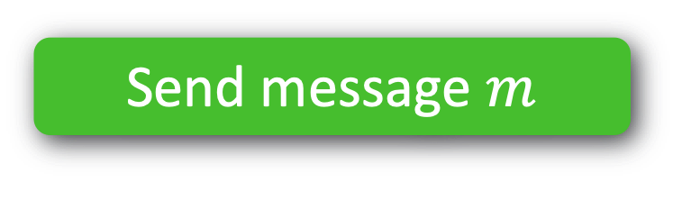
Send message $m$
Eavesdropper
Poly-time
$$\text{Enc}(m)$$
Hide $m$

Slide 14
Functionality
Template
Security
Privacy

Slide 15
1. MPC with Better Privacy
2. Hashing with Better Functionality
3. Encryption with Better* Security
*subjective & situational

Slide 16
1. MPC with Better Privacy
2. Hashing with Better Functionality
3. Encryption with Better* Security
*subjective & situational

Slide 17
1. MPC with Better Privacy
1. Topology-Hiding Computation
2. Hashing with Better Functionality
2. Robust Property Preserving Hashing
3. Encryption with Different Security
3. Fine-Grained Cryptography

Slide 18
1. Topology-Hiding Computation
2. Robust Property Preserving Hashing
3. Fine-Grained Cryptography

Slide 19
1. Topology-Hiding Computation

Slide 20

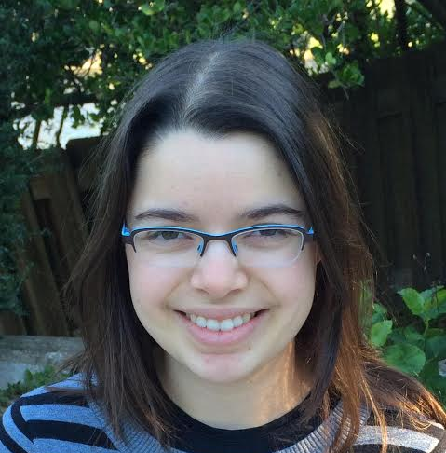


Computes functions on data & graph ☺
Holds personal data & “social graph” ☹
Facebook = “trusted third party”
Notes:
TODO:
Draw myself, Tal, and Adi
Draw FB logo
Draw randos

Slide 21
Goal: Decentralized Social Network
No trusted third party Privacy for data & graph
Notes:
TODO: replace imgs

Slide 22
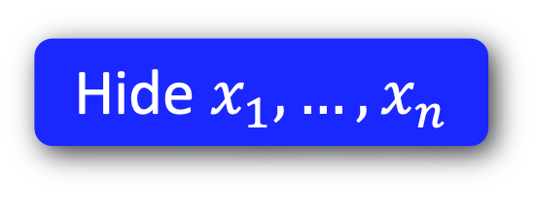
Functionality
MPC
MPC
Security
Passive
Compute $f(x_{1},…,x_{n})$
$$x_{2}$$
Active
$$x_{1}$$
$$x_{3}$$
Privacy for your data
Communication topology is public
Complete graph
General public topologies [Dolev-Dwork-Waarts-Yung’93, ..., Halevi-Ishai-Jain-Kushilevitz-Rabin’2016]
$$x_{4}$$
$$x_{6}$$
Hide $x_{1},…,x_{n}$
$$x_{5}$$
Privacy

Slide 23
Functionality
MPC
MPC
Security
Passive
Compute $f(x_{1},…,x_{n})$
$$x_{2}$$
Multiparty Computation (MPC) [Yao’86, GMW’87]:
multiple parties can jointly compute a function of their private inputs, while revealing nothing beyond the output
Active
$$x_{1}$$
$$x_{3}$$
Communication topology is public
Complete graph
General public topologies [Dolev-Dwork-Waarts-Yung’93, ..., Halevi-Ishai-Jain-Kushilevitz-Rabin’2016]
$$x_{4}$$
$$x_{6}$$
Hide $x_{1},…,x_{n}$
$$x_{5}$$
Privacy

Slide 24
Functionality
MPC
MPC
Security
Passive
Compute $f(x_{1},…,x_{n})$
$$x_{2}$$
Multiparty Computation (MPC) [Yao’86, GMW’87]:
multiple parties can jointly compute a function of their private inputs, while revealing nothing beyond the output
Active
$$x_{1}$$
$$x_{3}$$
Privacy for your data!
What about metadata?
Communication topology is public
Complete graph
General public topologies [Dolev-Dwork-Waarts-Yung’93, ..., Halevi-Ishai-Jain-Kushilevitz-Rabin’2016]
$$x_{4}$$
$$x_{6}$$
Hide $x_{1},…,x_{n}$
$$x_{5}$$
Privacy

Slide 25
Functionality
MPC
MPC
Security
Passive
Compute $f(x_{1},…,x_{n})$
$$x_{2}$$
Active
$$x_{1}$$
$$x_{3}$$
$$x_{4}$$
$$x_{6}$$
Hide $x_{1},…,x_{n}$
$$x_{5}$$
What about metadata?
Privacy

Slide 26
Functionality
Topology-Hiding Computation
MPC
MPC
Security
Passive
Compute $f(x_{1},…,x_{n})$
$$x_{2}$$
Active
$$x_{1}$$
$$x_{3}$$
$$x_{4}$$
$$x_{6}$$
Hide $x_{1},…,x_{n}$
$$x_{5}$$
Hide network
Privacy

Slide 27

Functionality
Topology-Hiding Computation
MPC
MPC
Security
Passive
Compute $f(x_{1},…,x_{n})$
$$x_{2}$$
Active
$$x_{1}$$
$$x_{3}$$
$$x_{4}$$
$$x_{6}$$
Hide $x_{1},…,x_{n}$
$$x_{5}$$
Hide network
Privacy

Slide 28
Topology-Hiding Computation [MoranOrlavRichelson15]
Parties have private inputs
Parties communicate directly only with neighbors.
1
8
2
7
3
4
6
5
The Goal: Given minimal information about the graph*
Compute any function of the inputs while revealing nothing beyond function’s output Reveal no more info about the graph
* bounds on diameter / #nodes
Notes:
In more detail, our setting is that parties all have their own private inputs
parties each know who their neighbors are and can communicate directly only with their neighbors
Our goal is to compute any MPC realizable function on the inputs while revealing nothing about the inputs or the graph
beyond minimal information, like the number of nodes or the diameter
To make our lives easier, we only need to realize topology-hiding broadcast. There are standard methods for compiling broadcast into MPC, and if the broadcast is TH, then the MPC will be as well.

Slide 29


Real
Simulated
Sim
1
b_{out}
1
8
2
$$≈$$
8
2
7
3
4
7
3
4
6
5
5
The Goal: Given minimal information about the graph*
Compute any function of the inputs while revealing nothing beyond function’s output Reveal no more info about the graph
* bounds on diameter / #nodes
Notes:
Mention static

Slide 30
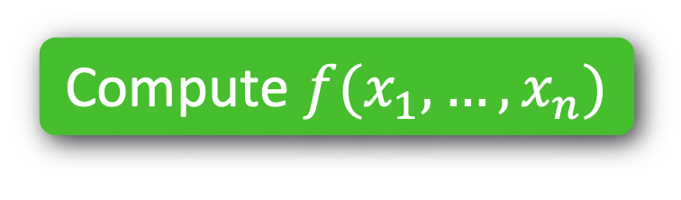
1. Topology-Hiding Computation
1. Quantum
Compute $f(x_{1},…,x_{n})$
2. Delaying
Hide $x_{1},…,x_{n}$
Hide network

Slide 31
1. Topology-Hiding Computation
1. Quantum
Compute $f(x_{1},…,x_{n})$
2. Delaying
Hide $x_{1},…,x_{n}$
Hide network

Slide 32
1. Topology-Hiding Computation
Standard Model
Adversary | Graph | Hardness Asm. | Reference
Semi-Honest | Log diam. | Trapdoor Perm | [MOR15]
 | Log diam. | DDH | [HMTZ16]
 | Cycles, trees… | DDH | [AM17]
 | Arbitrary | DDH, QR | [ALM17]
Fail-stop | Arbitrary | DDH, QR, LWE | [LLMMMT18]
Delaying | Cycles | DDH, QR, LWE | [LLMMMT20]
Notes:
TODO: write out citations

Slide 33
1. Topology-Hiding Computation
Standard Model
Adversary | Graph | Hardness Asm. | Reference
Semi-Honest | Log diam. | Trapdoor Perm | [MOR15]
 | Log diam. | DDH | [HMTZ16]
 | Cycles, trees… | DDH | [AM17]
 | Arbitrary | DDH, QR | [ALM17]
Fail-stop | Arbitrary | DDH, QR, LWE | [LLMMMT18]
Delaying | Cycles | DDH, QR, LWE | [LLMMMT20]
PKCR
Encryption

Slide 34
PKCR Encryption
(Privately Key-Commutative Randomizable)
Add Layer
[m]
sk₂
[m]
,
*
pk₁
pk₂
Delete Layer
sk₂
[m]
[m]
,
*
pk₁
pk₁
pk₂
Notes:
TODO: remove the green
Discuss that we’re not explicitely “adding a layer”, but rather changing the pks.
CT looks the same after this op: same as encrypting under fresh pk.

Slide 35
1. Topology-Hiding Computation
Quantum-Secure
DDH
or
PKCR
QR
or
LWE

Slide 36

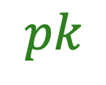
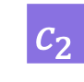


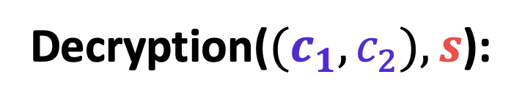
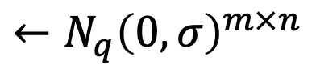


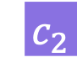


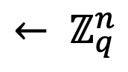
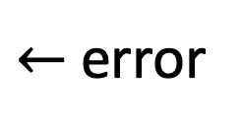



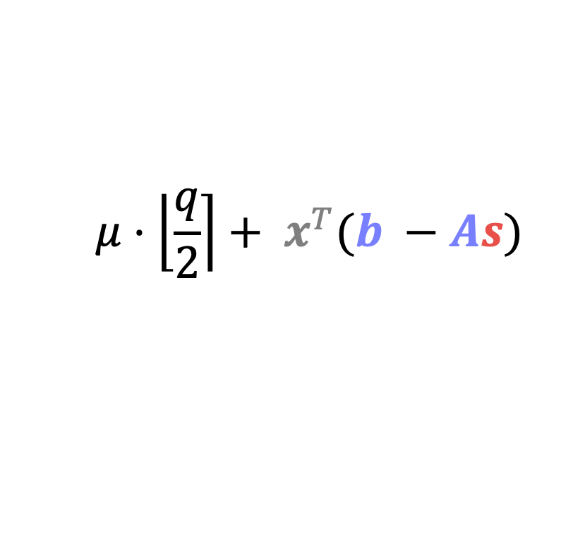

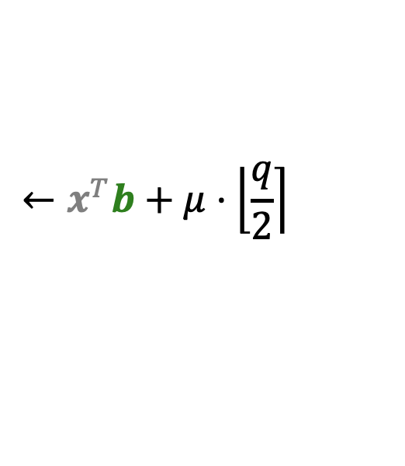

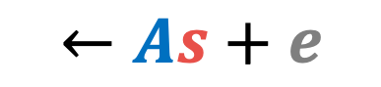
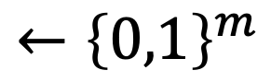


Regev’s PKE Scheme [Regev’05]
$$e$$
$$A$$
$$b$$
$$s$$
Keygen:
$$← ℤ_{q}^{n}$$
$←$ error
$$←N_{q}{\left(0,σ\right)}^{m×n}$$
$$←As+e$$
$$sk$$
Master PK
$$pk$$
$$←x^{T}A$$
$$←x^{T}b+μ⋅\left\lfloor \left.\frac{q}{2}\right\rceil \right.$$
$$x$$
$$c_{1}$$
$$c_{2}$$
Encryption($μ,A,b$):
$$←{\left\{0,1\right\}}^{m}$$
$$ct$$
$$μ← \left(\frac{q}{4},\frac{3q}{4}\right)∋\left[ − − \right]$$
$$s$$
Decryption($(c_{1},c_{2}),s$):
$$c_{2}$$
$$c_{1}$$
$$μ⋅\left\lfloor \left.\frac{q}{2}\right\rceil \right.+ x^{T}(b −As)$$
$$e$$
Notes:
TODO: flesh this out

Slide 37


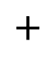






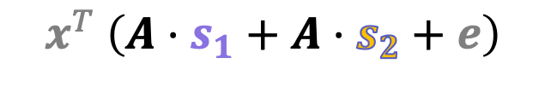

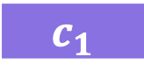

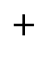
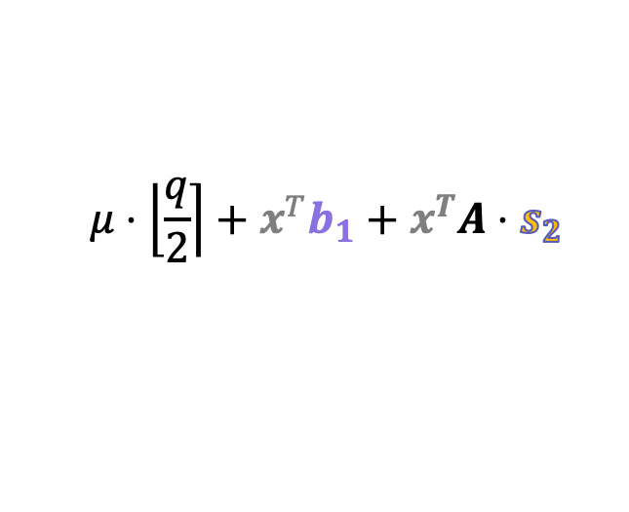


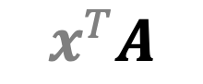
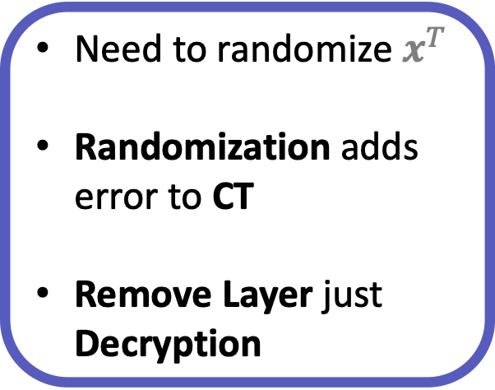
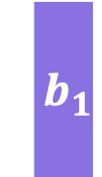

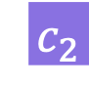




Regev’s PKE is PKCR [LLMMMT’18]
Add Layer
[m]
*
[m]
pk₁
sk₂
pk₁
pk₂
,
,
,
$${ b}_{1}$$
$${ b}_{1}$$
$${ b}_{2}$$
$$($$
$$c_{1}$$
$$,$$
$$c_{2}$$
$$)$$
,
,
$${ s}_{2}$$
$$+$$
,
$$($$
$$c_{1}$$
$$,$$
$$c_{2}$$
$$+$$
$$c_{1}$$
$${ s}_{2}$$
$$)$$
$$($$
$$x^{T}A$$
$$)$$
$$μ⋅\left\lfloor \left.\frac{q}{2}\right\rceil \right.+x^{T}b_{1}+x^{T}A⋅s_{2}$$
$$,$$
Need to randomize $x^{T}$
Randomization adds error to CT
Remove Layer just Decryption
$$\left(A⋅{(s}_{1}+s_{2})+e\right)$$
$$x^{T} \left(A⋅s_{1}+A⋅s_{2}+e\right)$$
$${ b}^{∗}$$
= pk*
Notes:
TODO: flesh this out

Slide 38
1. Topology-Hiding Computation
1. Quantum
Compute $f(x_{1},…,x_{n})$
2. Delaying
Hide $x_{1},…,x_{n}$
Hide network

Slide 39
1. Topology-Hiding Computation
1. Quantum
Compute $f(x_{1},…,x_{n})$
2. Delaying
Hide $x_{1},…,x_{n}$
Hide network

Slide 40
Impossibility of THC with Adversarial Delays
S
1
2
3
4
5
6
7
8
9
10
vs.
3
4
5
6
7
8
9
10
2
1
S
Which side is the source on?

Slide 41

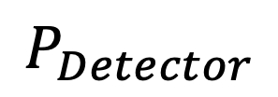
Impossibility of THC with Adversarial Delays
S
1
2
3
4
5
6
7
8
9
10
$$P_{Detector}$$
vs.
3
4
5
6
7
8
9
10
2
1
S
Which side is the source on?

Slide 42

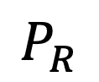
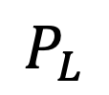
Impossibility of THC with Adversarial Delays
S
1
2
3
4
5
6
7
8
9
10
SLOW
SLOW
$$P_{Detector}$$
$$P_{L}$$
$$P_{R}$$
vs.
3
4
5
6
7
8
9
10
2
1
S
SLOW
SLOW
Which side is the source on?

Slide 43
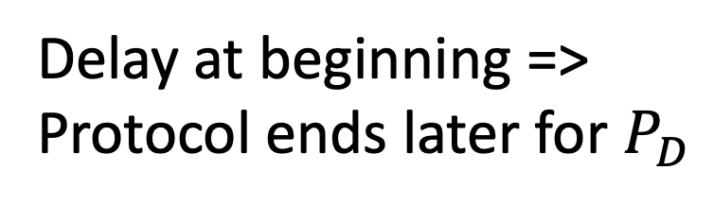

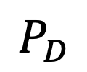
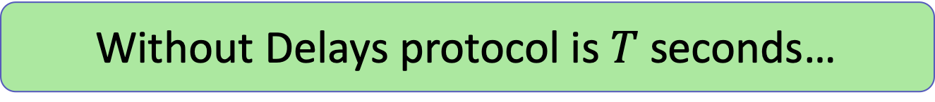
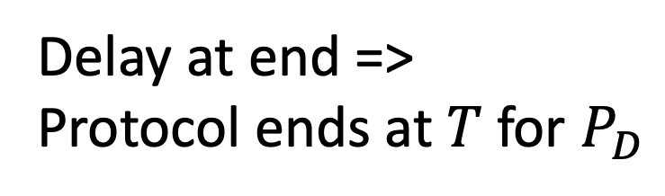
Impossibility of THC with Adversarial Delays
S
SLOW
SLOW
$$P_{D}$$
$$P_{L}$$
$$P_{R}$$
Without Delays protocol is $T$ seconds…
Delay $T$ seconds?
S
SLOW
SLOW
Delay at beginning =>
Protocol ends later for $P_{D}$
Delay at end =>
Protocol ends at $T$ for $P_{D}$

Slide 44
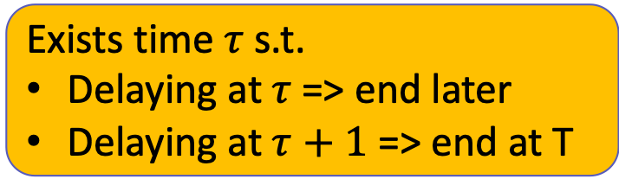
Impossibility of THC with Adversarial Delays
S
SLOW
SLOW
$$P_{D}$$
$$P_{L}$$
$$P_{R}$$
Exists time $τ$ s.t.
Delaying at $τ$=> end later
Delaying at $τ+1$ => end at T
S
SLOW
SLOW
Delay at beginning =>
Protocol ends later for $P_{D}$
Delay at end =>
Protocol ends at $T$ for $P_{D}$

Slide 45
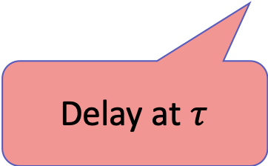
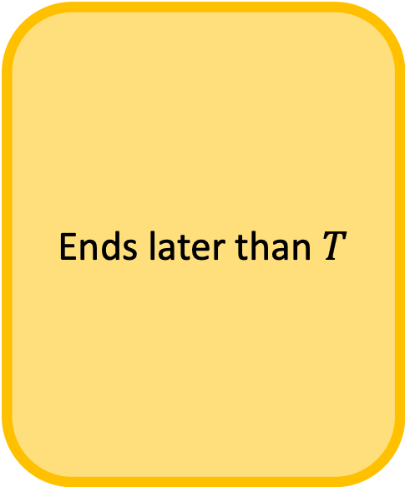



Impossibility of THC with Adversarial Delays
Ends later than $T$
Ends at $T$
S
SLOW
SLOW
$$P_{D}$$
$$P_{L}$$
$$P_{R}$$
Exists time $τ$ s.t.
Delaying at $τ$=> end later
Delaying at $τ+1$ => end at T
S
SLOW
SLOW
Delay at $τ$
Delay at $τ+1$

Slide 46

Impossibility of THC with Adversarial Delays
S
SLOW
SLOW
$$P_{D}$$
$$P_{L}$$
$$P_{R}$$
Exists time $τ$ s.t.
Delaying at $τ$=> end later
Delaying at $τ+1$ => end at T
Adversary guesses $τ$ correctly with probability 1/T
=>
Distinguish between two graphs w.p. ≥ ½ + 1/T

Slide 47
Summary of THC results
Quantum-Secure PKCR => Quantum-Secure THC
Via LWE
Adversaries that can delay messages can learn topology
Any THC result dealing with real-world networks must not allow adversarial control over message timings OR must leak information
Lead to positive result in the Probabilistic Unknown Delay Model [LLMMMT20]
SLOW

Slide 48
1. Topology-Hiding Computation
2. Robust Property Preserving Hashing
3. Fine-Grained Cryptography

Slide 49
2. Robust Property Preserving Hashing
Hash Function Access
Hamming Distance
Greater-than

Slide 50









Locality Sensitive Hashing (LSH)[Indyk-Motwani‘98]
For every $x, x’$:
$x,x^{′}$ CLOSE $⟹$ $Pr[$choose $h$ s.t. $h\left(x\right), h(x^{′})$ CLOSE$]≥p_{1}$
$x,x^{′}$ FAR $⟹$ $Pr[$choose $h$ s.t. $h\left(x\right), h(x^{′})$FAR $]≥p_{2}$
$$≈$$
$$≉$$
$$≈$$
$$≉$$
Notes:
Useful for quickly checking membership/etc... Check against a hashed version of data

Slide 51







Locality Sensitive Hashing (LSH)[Indyk-Motwani‘98]
For every $x, x’$:
$x,x^{′}$ CLOSE $⟹$ $Pr[$choose $h$ s.t. $h\left(x\right), h(x^{′})$ CLOSE$]≥p_{1}$
$x,x^{′}$ FAR $⟹$ $Pr[$choose $h$ s.t. $h\left(x\right), h(x^{′})$FAR $]≥p_{2}$
$$h$$
$$≈$$
$$≉$$
But if adversary knows hash,
can adapt!
$$≉$$
$$≈$$
$$≈$$
Notes:
Note that there is a gap between close and far here.
R versus cR.
*In fact, all known LSH’s are completely broken.*

Slide 52


Goal: Robust LSH
Close inputs remain close
Far inputs remain far!
$$h$$
$$h$$
Bad inputs exist, but computationally hard to find!
$$≈$$
$$≉$$
$$≈$$
$$≉$$

Slide 53





Goal: Robust for generic predicate $P$
Even given access to hash, adversary cannot fool evaluation.
$$h$$
$$h$$
$$P\left(x,x^{′}\right)=1$$
$$P\left(x,x^{′}\right)=0$$
$$≈$$
$$≉$$
$$Eval(h,h\left(x\right), h(x^{′}))=1$$
$$Eval(h,h\left(x\right), h(x^{′}))=0$$
$$≈$$
$$≉$$

Slide 54

Applications
Take large datasets and compare compressed or sketched versions
Legal Forensic Discovery
Documents
DNA evidence
Biometrics to determine membership
$$≈$$
$$≈$$
Notes:
Legal forensic discovery: correctly approximating similarity between documents so as to discover important evidence that can strengthen their case, while the defending company might prefer to masquerade evidence by causing mis-approximation
$9.9 billion dollar industry, apparently
Deloitte, “GCC eDiscovery survey, How ready are you?” https:
//tinyurl.com/jp2qwey, 2015

Slide 55



Prior Work
$$h$$
LSH/Sketching constructions (typically linear)
$ℓ_{p}$ norm [IM’98, GIM’99, ADIIM’06,…]
Sketching algorithms [AMS’99, Ind’07, Mut’05]
Linear hashes/sketches CANNOT be robust [HW’13]
Progress to robustness:
interactive [MNS’08]
Specific tasks or attacks (e.g. [NY’15])
Notes:
Been a lot of ML stuff…wide range of recent attacks within machine learning in adversarial environments (e.g., [20, 17, 28, 26, 16])
Weaker adversary

Slide 56


2. Robust Property Preserving Hashing
Hamming Distance
Greater-Than
1. Lower bounds vs Passive
2. Constructions vs Adaptive
$$h$$
Passive
Adaptive

Slide 57














Definitions
Robust PPH family $H$ for two-input predicate $P$
$$h←H.Samp\left(1^{n}\right)$$
$n$ bits
$P$(
$$x$$
$$,$$
$$x′$$
$$)$$
$$\{0,1\}$$
$$H.Eval(h,$$
$$h(x)$$
$$,$$
$$h(x^{′})$$
$$)$$
$$\{0,1\}$$
$m$ bits
and robust

Slide 58





Notions of Robustness
Non-robust
$∀ x$ and $x’$
$$\underset{h}{Pr}\left[H.Eval\left(h,h\left(x\right),h\left(x^{′}\right)\right)≠P\left(x,x^{′}\right)\right]≤negl(n)$$
Robust
$∀$PPT adversaries $𝒜$
$$\underset{h,𝒜}{Pr}\left[𝒜\left(h\right)→\left(x,x^{′}\right) s.t. H.Eval\left(h,h\left(x\right),h\left(x^{′}\right)\right)≠P\left(x,x^{′}\right)\right]≤negl(n)$$
Challenger
$$h←H.Samp\left(1^{n}\right)$$
$$h$$
$(x,x^{′})$ s.t.
$$H.Eval\left(h,h\left(x\right),h\left(x^{′}\right)\right)≠P\left(x,x^{′}\right)$$

Slide 59





Warmup: Equality-Preserving Hash
(Collision-Resistance Hash Families)
Given $h$ sampled from $H$, hard to find a collision
Challenger
$$h←H.Samp\left(1^{n}\right)$$
$$h$$
$(x,x^{′})$ s.t.
$h\left(x\right)=h(x^{′})$ and $x≠x′$
One of $H.Eval$must be incorrect:
$$H.Eval\left(h,h\left(x\right),h\left(x^{′}\right)\right)=H.Eval\left(h,h\left(x\right),h\left(x\right)\right)$$

Slide 60



Warmup: Equality-Preserving Hash
(Collision-Resistance Hash Families)
In other words…
$H$ is CRHF
$$⇔$$
$H$is Equality PPH
Same security guarantees!
Notes:
“We would like to get PPH for properties other than equality, so…”

Slide 61
2. Robust Property Preserving Hashing
1. Lower bounds vs Passive
Hamming Distance
Greater-Than

Slide 62






Gap-Hamming Predicate
Let $P(x,x’)$ be the $(n,d,ε)$ Gap-Hamming Predicate
$$0$$
If $\left|x⊕x^{′}\right|≤d(1 −ε)$
“CLOSE”
$$P(x,x′)=$$
$$1$$
If $\left|x⊕x^{′}\right|≥d(1+ε)$
“FAR”
$$⋆$$
Otherwise
Notes:
So, we focus on the gap-hamming predicate, which instead of just giving equal-or-not, can describe whether two inputs are close or far.
Ideally you want constant fraction for d…

Slide 63








One-Way Communication Model
Evaluate function $P$ on $x, x’$
Public randomness $r$
$$g_{a}\left(x,r\right)$$
$$P(x,x^{′})$$
$$x$$
$$x′$$
$$r$$
$$r$$
w.p. $≥p$
Goal: minimize ${|g}_{a}\left(x,r\right)|$
Notes:
Any LB in OWCC => LB for hash functions, BUT we need exact LBs
We show impossibility for a gap-hamming predicate with a relatively small gap – note that our constructions have a relatively large gap, and so gets around this LB.
…
Emphasize what we do
2 mins

Slide 64







PPH implies OWC Protocol
Evaluate predicate $P$ on $x, x’$
Publicly sampled $h$
$$h(x)$$
$$H.Eval$$
$$P(x,x^{′})$$
$$x$$
$$x′$$
$$h$$
$$h$$
w.p. $≥1 −negl(n)$

Slide 65


















PPH implies OWC Protocol
OWC Protocol
$$⟸$$
Robust PPH
$P$(
$$x$$
$$,$$
$$x′$$
$$)$$
$$g_{a}\left(x,r\right)$$
$$P(x,x^{′})$$
$$x$$
$$x′$$
w.p. $≥1−negl$
$$H.Eval(h,$$
$$h(x)$$
$$,$$
$$h(x^{′})$$
$$)$$
$$r$$
$$r$$
Lower bound $\left|g_{a}\left(x,r\right)\right| ⟹$ Lower bound on $|h\left(x\right)|$
Existing OWC lower bounds of form $Ω(n)$… but we need to be exact!

Slide 66





Existing Lower Bounds from OWC
$$h(x)$$
$$H.Eval$$
$$P(x,x^{′})$$
$$x$$
$$x′$$
$\left(n,\frac{n}{2},\frac{c}{\sqrt{n}}\right)$-Gap-Hamming requires $Ω(n)$ bits of OWC [﻿Jayram-﻿Kumar-﻿Sivakumar’08]
$\left(n,\frac{n}{2},\frac{1}{\sqrt{n}}\right)$-Gap-Hamming requires $n$ bits of OWC [This Work]
Greater-Than requires $Ω(n)$ bits of OWC [﻿Ramamoorthy-Sinha’15]
Greater-Than requires $n$ bits of OWC [This Work]

Slide 67
Existing Lower Bounds from OWC
$$h(x)$$
$$H.Eval$$
$$P(x,x^{′})$$
$$x$$
$$x′$$
$\left(n,\frac{n}{2},\frac{c}{\sqrt{n}}\right)$-Gap-Hamming requires $Ω(n)$ bits of OWC [﻿Jayram-﻿Kumar-﻿Sivakumar’08]
$\left(n,\frac{n}{2},\frac{1}{\sqrt{n}}\right)$-Gap-Hamming requires $n$ bits of OWC [This Work]
Refinement of analysis…
Greater-Than requires $Ω(n)$ bits of OWC [﻿Ramamoorthy-Sinha’15]
Greater-Than requires $n$ bits of OWC [This Work]
Greater-Than is a Reconstructing Predicate

Slide 68






Reconstructing Predicate $P$
Learner
Query $x_{i}$
$$P , x$$
$$P({x,x}_{i})$$
E.g: Index, Greater-Than, Exact-Hamming,…
$$x′$$
$x^{′}=x$ with 1 – negl(n) probability

Slide 69


Reconstructing Predicate Lower Bounds
$$P , x$$
$$x′$$
If $P$ is reconstructing, then a (nontrivial) PPH does not exist for $P$.
Intuition: $P$ can describe all $n$ bits of $x$, so cannot compress…

Slide 70











Example: Greater Than
$$>,x$$
$$h\left(x\right)$$
$$P\left(x,x^{∗}\right)$$
or
$P\left(x^{′},x^{∗}\right)$?
$$x$$
$$x^{∗}$$
Binary search
$$∃x^{′}≠x$$
$$h(x)=h(x’)$$
w.p. at least 1/2
$$x^{∗}$$
$$x$$
0
$$2^{n}−1$$
$$x′$$
$$P\left(x,x^{∗}\right)≠P\left(x^{′},x^{∗}\right)$$

Slide 71


Example: Greater Than
$$>,x$$
$$h\left(x\right)$$
$$P\left(x,x^{∗}\right)$$
or
$P\left(x^{′},x^{∗}\right)$?
$$x$$
$$x^{∗}$$
Binary search
Third Query!
$$x$$
0
$$2^{n}−1$$
Need to guess which query (with prob 1/n)
$$x′$$
Query 1
Query 2
Notes:
Notice that later queries do NOT distinguish x and x’.. Just the one

Slide 72
PPH Lower Bounds: Gap-Hamming

Slide 73
2. Robust Property Preserving Hashing
$$h$$
2. Constructions vs Adaptive
Hamming Distance
Adaptive

Slide 74
PPH Constructions for Gap-Hamming Distance
Both use same concept
Collision-Resistant Hash functions
Common, weak assumption
New coding-theoretic assumption
Different parameters
Related to hardness of syndrome decoding
Expand
Compress
Notes:
The goal: try to extend beyond just equality!
In this work, we give constructions focused on gap hamming distance

Slide 75
Gap-Hamming PPH from CRHFs
CLOSE inputs have many EQUAL subsets
0
0
1
0
0
1
1
0
1
0
1
1
0
1
0
0
0
1
0
1
0
0
1
1
Notes:
… apply CRHF and finish construction!

Slide 76
Gap-Hamming PPH from CRHFs
CLOSE inputs have many EQUAL subsets
0
0
1
0
0
1
1
0
1
0
1
1
0
1
0
0
0
1
0
1
0
0
1
1
So, CRH’s of these subsets should also agree
1
0
1
1
0
0
Notes:
… apply CRHF and finish construction!

Slide 77
Gap-Hamming PPH from CRHFs
FAR inputs have few EQUAL subsets
0
0
1
1
0
0
1
0
0
0
1
1
0
1
0
1
0
0
0
0
0
0
1
1

Slide 78
Gap-Hamming PPH from CRHFs
FAR inputs have few EQUAL subsets
0
0
1
1
0
0
1
0
0
0
1
1
0
1
0
1
0
0
So, CRH’s of these subsets should disagree
0
0
0
0
1
1
1
1
0
0
0
1
Or violate security of CRH!

Slide 79
Final Construction
0
0
1
1
0
0
Expander graph
0
0
0
1
0
1
0
0
CRH
0
1
1
0
Notes:
Expander – more subsets
CRHF

Slide 80


Final Construction
0
0
1
1
0
0
$(n,d,ε)$ Gap-Hamming
$d=O\left(n^{1−δ}\right)$
$ε=O(1)$
Any constant compression!
0
0
0
1
0
1
0
0
0
1
1
0
Notes:
Get a larger center d if we assume exponentially secure CRHFs
(idea: subsets in the middle can be smaller)

Slide 81






Coding-Theoretic PPH Construction
Nearest-Neighbor Construction [Kushilevitz-Ostrovsky-Rabani’98]
Way too good…
n
For any:
$d∈\left[n\right]$
$ε=Ω\left(1\right)$
$m=Ω(n)$
$$A$$
$$x$$
m
$$y$$
=
m
Ber$(1/d)$ entries
Not robust!!!
For threshold $τ=τ(n,d,ε)$, for any $x∈{\left\{0,1\right\}}^{n}$
$\left|x\right|≤ d(1−ε),$then $\underset{A}{Pr}\left[\left|Ax\right|>τ\right]=negl\left(n\right)$
$\left|x\right|≥ d(1+ε),$then $\underset{A}{Pr}\left[\left|Ax\right|<τ\right]=negl\left(n\right)$
Notes:
Note that here x is the difference between two inputs. Because everything is linear, we just care about preserving the hamming weight of the difference.
Also note that this is a NON ROBUST construction, which is why we can get a d like that…
Computing tau:
Mu_1 = m/2 (1 – e^{-2(1 – eps)} )
Mu_2 = m/2 (1 – e^{-2(1 + \eps)} )
Go through the probability that any row in A dotted with x is 1 conditioned on the weight of x and then you can get these bounds.
Tau = ½ (mu1 + mu2)

Slide 82

Coding-Theoretic PPH Construction
Getting robustness…
n
For any:
$d=n/\log{n}$
$ε=Ω\left(1\right)$
$m=Ω(n)$
$$A$$
$$x$$
m
$$y$$
=
m
Ber$(1/d)$ entries
If $d$ small enough, then $\underset{A}{Pr}\left[∃\left|x\right|≤d\left(1−ε\right) s.t. \left|Ax\right|>τ\right]=negl\left(n\right)$
Large vectors and Gaussian Elimination?
What if our domain is SPARSE?
Notes:
Small enough d = n/log n
Computing tau:
Mu_1 = m/2 (1 – e^{-2(1 – eps)} )
Mu_2 = m/2 (1 – e^{-2(1 + \eps)} )
Go through the probability that any row in A dotted with x is 1 conditioned on the weight of x and then you can get these bounds.
Tau = ½ (mu1 + mu2)

Slide 83







Coding-Theoretic Assumption
Let $x∈{\left\{0,1\right\}}^{n}$ be $β$-sparse.
$\left|x\right|≤d(1 −ε)$ is “small” and $d\left(1+ε\right)≤\left|x\right|≤βn$ is “medium”
n
$$A$$
$$A$$
$$x$$
m
$$y$$
=
m
$x$ s.t.
$|x|$ and $|y|$…
Know:
$|x|$ small or medium
$|y| = 0$ is hard (Syndrome Decoding)
[Applebaum-Haramaty-Ishai-Kushilevitz-Vaikuntanathan’17]
Assumption:
$|x|$ medium
$|y|$ small (less than $τ$) is hard
Notes:
Computing tau:
Mu_1 = m/2 (1 – e^{-2(1 – eps)} )
Mu_2 = m/2 (1 – e^{-2(1 + \eps)} )
Go through the probability that any row in A dotted with x is 1 conditioned on the weight of x and then you can get these bounds.
Tau = ½ (mu1 + mu2)

Slide 84








Coding-Theoretic Construction
$$x′$$
$(n,d,ε)$ Gap-Hamming
$$x$$
Sparsify:
Non-linear
Deterministic
Approx. preserves Hamming dist.
For any:
Constant compression*
$ε=O\left(1\right)$
$d≤\frac{n}{2\log{n}}(\left(1 −ε\right)+\left(1+ε\right))$
$$Ax′$$
$$y$$
Ber$(1/d)$
Recall CRHF construction:
$$d=O\left(n^{1−δ}\right)$$
$β$-sparse
* Depending on the assumption you’re willing to make…

Slide 85






Landscape of PPH’s
No compression
Lots of Compression
$≥n$ bits
$O(n)$ bits
$ω(log\left(n\right))$ bits
$0$ bits
Constant Gap-Hamming
CRHF Construction
Coding Construction
$$\text{Equality}\text{ (}\text{CRHFs}\text{)}$$
$1/\sqrt{n}$ Gap-Hamming, Index, Greater-than,…
One-Way Communication
[This work]
Notes:
“In the second construction, we can handle d = n/log n.”

Slide 86
1. Topology-Hiding Computation
2. Robust Property Preserving Hashing
3. Fine-Grained Cryptography

Slide 87

3. Fine-Grained Cryptography
Messaging in O(n^a) time
$O(n^{c})$-Time
C >> a
Messages

Slide 88
“In a world”
… where OWFs don’t exist…
… where BPP is functionally equivalent to NP…
… called Pessiland…
Can we still have meaningful cryptography?
Three intrepid researchers find out…
Three intrepid researchers find out…
Notes:
In a world
Where one way functions don’t exist
Where bpp is functionally equivalent to NP
A world called Pessiland
Can we still have meaningful cryptography
Three intrepid researchers find out!

Slide 89
BPP ≠ NP
(=> P ≠ NP)
Average Case Hard problems
Efficiently generate hard distribution + know solutions
One-Way Function
Efficiently generate hard distribution + trapdoor
Public key crypto
Notes:
TODO: this slide should introduce the core issues of a world without OWFs, why we rely on P ≠ NP for crypto

Slide 90
Rely on increasingly strong assumptions about P & BPP
BPP ≠ NP
(=> P ≠ NP)
Average Case Hard problems
Efficiently generate hard distribution + know solutions
One-Way Function
Efficiently generate hard distribution + trapdoor
Public key crypto
Notes:
TODO: this slide should introduce the core issues of a world without OWFs, why we rely on P ≠ NP for crypto

Slide 91


BPP ≠ NP
(=> P ≠ NP)
Average Case Hard problems
Different kind of assumption:
Polynomial Hardness
Efficiently generate hard distribution + know solutions
One-Way Function
$O(n^{2})$ vs.
$$O(n^{3})$$
Efficiently generate hard distribution + trapdoor
Public key crypto
Notes:
TODO: this slide should introduce the core issues of a world without OWFs, why we rely on P ≠ NP for crypto

Slide 92

Related works
Concrete Security Reductions: [BKR94, BCK96, BDJR97, BR09]
Subset Sum: [IN02]
Fine Grained Complexity: [WW10, CGIM+15, ACKL17, W18, ABW18, …]
Fine-Grained Worst Case to Average Case Reductions: [BRSV17,GR18,ABB19]
Lower Bounds Against Fine-Grained Crypto: [BC19]
Notes:
TODO: Add a bullet about FG Complexity (with tons of citations + ...)
Flow: WC FG Complexity -> FG WC to AC -> ...?
M. Ball, A. Rosen, M. Sabin, and P. N. Vasudevan 17
[GR’18] Goldriche Rothbloom
[ABB’19] Adserà, Brennan, Bresler
[BC19] Brzuska, Couteau
Concrete: different because they are concerned with how the sec param changes, while we care a lot about the polynomial overheads in the reductions themselves, even outside of the ones that change the sec param.
M. Bellare, J. Kilian, and P. Rogaway 1994
M. Bellare, R. Canetti, and H. Krawczyk 1996M. Bellare, A. Desai, E. Jokipii, and P. Rogaway 1997
M. Bellare and T. Ristenpart.2009
. R. Impagliazzo and M. Naor.2002
‘There exists an oracle relative to which no fine-grained one way function exists (roughly a “random language”)’

Slide 93
Can we have a meaningful notion of cryptography even if we don’t have OWFs?
Notes:
TODO: put this in bold in the middle

Slide 94
Can we have a meaningful notion of cryptography even if we don’t have OWFs?
YES!
Notes:
TODO: put this in bold in the middle

Slide 95

Related works: Fine Grained Public Key Crypto
Paper | Assumptions | Crypto | Run Time | Adversary Time
[M78] [BGI08] | $2^{n}$-Strong OWFs | Key Exchange | $$O(N)$$ | $$Ω(N^{2})$$
Notes:
To start off this discussion, let’s mention Merkle Puzzles, the original fine-grained key exchange. Based on either Random Oracles, or very very strong OWFs, we can get a key exchange with an N^2 “gap” between runtime and the time it takes an adversary to break.
But wait, we said we were in a world without OWFs…
Merkle 78
E. Biham, Y. J. Goren, and Y. Ishai. 08,
M. Ball, A. Rosen, M. Sabin, and P. N. Vasudevan 18
A. Degwekar, V. Vaikuntanathan, and P. N. Vasudevan 16

Slide 96

Related works: Fine Grained Public Key Crypto
Paper | Assumptions | Crypto | Run Time | Adversary Time
[M78] [BGI08] | $2^{n}$-Strong OWFs | Key Exchange | $$O(N)$$ | $$Ω(N^{2})$$
[DVV16] | NC1≠⊕L/poly | OWF + PKE | NC1 | >NC1
Polynomial assumption?
Notes:
There was some recent work by Degwekar, Vaikuntanathan, and Vasudevan showing how to get Key Exchanges (and Public Key Encryption) from an assumption about the nature of NC1. This does fit the bill of being crypto without OWFs, but what if we don’t want to rely on circuit-complexity and P/Poly?
Merkle 78
E. Biham, Y. J. Goren, and Y. Ishai. 08,
M. Ball, A. Rosen, M. Sabin, and P. N. Vasudevan 18
A. Degwekar, V. Vaikuntanathan, and P. N. Vasudevan 16

Slide 97

Related works: Fine Grained Public Key Crypto
Paper | Assumptions | Crypto | Run Time | Adversary Time
[M78] [BGI08] | $2^{n}$-Strong OWFs | Key Exchange | $$O(N)$$ | $$Ω(N^{2})$$
[DVV16] | NC1≠⊕L/poly | OWF + PKE | NC1 | >NC1
[This Work] | Average-Case Zero k-Clique | OWF PKE PKE | $O(N)$ $$O(N)$$ $$O(N)$$ | $$Ω(N^{k/2 })$$ $$Ω\left(N^{1.5−δ}\right)$$ $$Ω(N^{2−δ})$$
Generic properties
Specific properties of Zero-k-Clique
Notes:
That’s where our work comes in. We make an assumption about Zero-k-Clique, which is a popular problem studied in fine-grained complexity, and build both FG OWFs and even Public Key Encryption from it!
Merkle 78
E. Biham, Y. J. Goren, and Y. Ishai. 08,
M. Ball, A. Rosen, M. Sabin, and P. N. Vasudevan 18
A. Degwekar, V. Vaikuntanathan, and P. N. Vasudevan 16

Slide 98
Can we have a meaningful notion of cryptography even if we don’t have OWFs?
YES!
And can use fine-grained complexity assumptions!
2. Assumptions
Zero-k-Clique
3. Construction
FG Key Exchange
1. Definitions
FG OWFs
FG KeyXC
Notes:
Hand over to RIO!

Slide 99








1. Definitions: The Wild World of Fine-Grained Crypto
Classical OWF $f$
$n^{c}$-Fine-Grained OWF $f$
Evaluate in polytime
Evaluate in $O(n^{c})$
$$𝒜 \text{inverts} f\left(x\right)$$
$$\text{then}$$
$𝒜$ inverts $f\left(x\right)$
then
$$=\text{superpoly}(n)$$
$$=Ω(n^{c+δ})$$

Slide 100





1. Definitions: Fine-Grained Key Exchange
Transcript
$$b$$
$$b$$
$$=O(n^{c})$$
$$=O(n^{c})$$
$$=Ω(n^{c+δ})$$
Notes:
If the adversary takes LESS THAN T(n) time, then cannot invert!

Slide 101









2. Fine-Grained Problem Zero k-Clique
Distribution
Complete k-partite graph
$w_{i,j}\sim ℤ_{R}$
$a,b,c\sim [n]$
$w_{a,b}=−(w_{a,c}+w_{b,c})$
$$w_{i,j}$$
$$n$$
$$a$$
$$b$$
Average-Case Assumption
Finding $a,b,c$ takes
$$c$$
$$={Ω(n}^{k})$$
$3$-partite

Slide 102











3. Fine-Grained Key Exchange Merkle Puzzles?
9
8
7
Input Universe ${\left\{0,1\right\}}^{n}$
6
5
4
1
publish $2^{n/2}$evaluations
2
3
4
4
$$f( )$$
2
$$f( )$$
7
1
2
1
9
$$f( )$$
$$f( )$$
4
4
Key $=$
$$f( )$$
Key $=$
4
4
$$f( )$$
9
7
$$=O({2^{n/2}n}^{2})$$
$$=O({2^{n/2}n}^{2})$$
$$=Ω(n^{k})$$
Notes:
Rio
Explicitly mention: OWF needs an exponential gap [BGI08]

Slide 103


3. Fine-Grained Key Exchange Merkle Puzzles, but different
Generate $ℓ$ ZkC Instances
Plant $\sqrt{ℓ}$solutions
Check Alice’s list for solution
Notes:
Rio

Slide 104




3. Fine-Grained Key Exchange Merkle Puzzles, but different
Generate $ℓ$ ZkC Instances
Plant $\sqrt{ℓ}$solutions
Check Alice’s list for solution
5. $b=\left\langle i,v\right\rangle$
$$\text{index} i$$
4. Publish $v\sim U_{\log{(ℓ)}}$
$$v$$
Notes:
Rio

Slide 105




3. Fine-Grained Key Exchange Merkle Puzzles, but different
Generate $ℓ$ ZkC Instances
Plant $\sqrt{ℓ}$solutions
Check Alice’s list for solution
5. $b=\left\langle i,v\right\rangle$
Time Alice & Bob:
$O(ℓn^{2})$
$O(\sqrt{ℓ})$
$O(\sqrt{ℓ}⋅n^{k})$
$$n^{2k−4}$$
$${O(n}^{2k−2 })$$
Notes:
Rio
After minimizing wrt ell and n, we get that A & B only need n^{2k – 2} time to run this protocol.
ell = n^{2k – 4}
… Hope that Eve

Slide 106



3. Fine-Grained Key Exchange Merkle Puzzles, but different
$$n^{2k−4}$$
$${O(n}^{2k−2 })$$
$${O(n}^{2k−2 })$$
Need a proof!
$$=Ω(n^{3k −4})$$
Notes:
Rio

Slide 107
3. Fine-Grained Key Exchange Security reduction
LOCATION
of the ZKC
Index of the
ZKC pair
Reduces
i
Notes:
Andrea!
What we want is reduce finding the location of a zero k clique to finding an index of a matching pair of indicies with a solution.

Slide 108

3. Fine-Grained Key Exchange ZkC Properties
Three Properties
List Hard
Splittable
Plantable
01011101
Notes:
ANY PROBLEM WITH THESE PROPERTIES
We can do this with three properties. It is both the case that ZKC has these properties and that any problem with these properties will create a PKE.
Listhard, which lets us say that finding the index of a solution in a list requires that every problem in that list be solved in n^k time. This is an efficient self reduction.
Splittable splits the high order bits and low order bits of the weights on the edges, so you’ll start with one problem that has weights mod R and end up with two problems over mod sqrt(R).
Finally, plantable. We need to be able to plant cliques into instances with out any.

Slide 109





3. Fine-Grained Key Exchange Security reduction
01011101
$$ℓ$$
$$n^{k}$$
i
i
i
$${ℓn}^{k}$$
$${ℓn}^{k}$$
$${ℓn}^{k}$$
Notes:
We go from clique location to the index of the problem with a solution in a list. To do this we use list hard (creative naming I know)
The hardness of a list of ell instances of size n is ell n^k.
Next we want to show that a PAIR of instances is hard to find, for this we use the splittalbe property. We take every instance and split it into two instances. If it started with a solution both have one, else neither do.
Finally, we plant the remaining root ell minus one instances in each list to bring the problem back to breaking the key exchange. We use plant ability for this.

Slide 110
3. Fine-Grained Key Exchange List Hard
…
Notes:
Lets give an explanation of why zkc is list hard.
Given an instance we will split the problem, consider here splitting every vertex set in two. There are 8 possible combinations of these split vertex sets. In general if we have zkc and we split \ell times then we have ell^k instances.
One of these instances will contain the original clique, here the green moon, green star and green sun instance.
There is correlation between the instances, and we want the instances to be uncorrelated. We acheive this by making multiple lists, if you are interested in this talk to us offline.

Slide 111



3. Fine-Grained Key Exchange List Hard
If $ℓ$ groups:
$ℓ^{k}$ problems
size $\left|V\right|=n/ℓ$
$$ℓ^{k}$$
…
$$n/ℓ$$
Notes:
Why is this sufficient? Well, when we produce ell ^k instances each of size \n/\ell we can ask how long each problem must take.

Slide 112

3. Fine-Grained Key Exchange List Hard
$$n^{k}=ℓ^{k}{\left(\frac{n}{ℓ}\right)}^{k}$$
$$ℓ^{k}$$
…
$$n/ℓ$$
Notes:
We know that that the time must work out to be n^k, and as it turns out saving over (n/ell)^k would propagate an improvement (if ell is polynomially large enough)

Slide 113
3. Fine-Grained Key Exchange Security reduction
01011101
i
i
i
Correlations
Carries
Double-planting
Notes:
Andrea
There is a significant amount of error and correlation to deal with here.

Slide 114



OWFs + HC Bits
Modified Goldreich-Levin
OWFs from Planting
Witness = hard-core set
$$f(r,s) =(Gen(n,1; r),wit⋅ s )$$
a
b
Gen(n,1; r) =
Security Reduction $O(\text{polylog} n)$
c
random weights
a
b
c
‘Weak’ to ‘Strong’
wit
$$O(log⁡n)$$
Advantage 1 – 1/sub-poly
< 1/sub-poly (for-all sub-poly)

Slide 115



FG Crypto Summary of results
Definitions
FG-OWFs and FG-HC bits
FG-KeyXC
FG-PKE
Assumptions
3-Sum and k-Sum
Zero-k-Clique
Constructions
FG-OWF and HC Bits
FG-KeyXC and PKE
$$={O(n}^{2k−2 })$$
$$={Ω(n}^{3k−4 })$$
“Better KeyXC” with gap ${O(n}^{k+2 })$ vs ${Ω(n}^{2k })$

Slide 116
Summary
1. Topology-Hiding Computation
2. Robust Property Preserving Hashing
3. Fine-Grained Cryptography

